Slide 1
Life cycle assessment (LCA) in the Puro Standard 2023-03

Slide 2
What is life cycle assessment?
LCA is a scientific method for quantifying the potential environmental impacts associated with a product, a service or a system. The main purpose of LCA is to guide decision making towards reducing environmental impacts, while avoiding shifting of burdens between life cycle stages, environmental impact categories and generations.
LCA exists in many forms (e.g. standalone, comparative, attributional, consequential, prospective, static, dynamic, exploratory, regionalized, and more). LCA is used in research, policy, and business for various purposes. Despite the variety of LCA forms, the golden rule is that “the way an LCA study is performed must be in line with its goal”.
Often, LCA is limited to quantifying climate change impacts and does not investigate other types of environmental impacts. This is enough for certification in the Puro Standard.
Note also that an LCA (even limited to climate impacts) is not the same as a greenhouse gas inventory.

Slide 3
The goal of an LCA study when performed for certification under the Puro Standard
The goal of an LCA performed for Puro is to demonstrate the net-negativity of a removal activity in line with the scope defined in the corresponding Puro methodology. Thereby, the LCA enables the calculation of CORCs that a project can issue in the Puro registry.
The scope defines the rules of accounting for a given removal method. These rules include e.g. what system boundaries to apply, how to deal with multi-functionality issues, and other necessary adjustments.
Some rules are general and apply to all methodologies in the Puro Standard
Some rules are specific to a given removal method, and they condition eligibility
Theoretical LCA remarks:
Note that the notion of “net-negativity” has no meaning if not associated to a precise scope. The scope defined in the Puro methodology is crucial. The way an LCA scope is defined allow us to benchmark removal projects against one another, allow us to focus exclusively on carbon removal and avoid other unsustainable pitfalls.
Note that the “net-negativity” of an activity relative to a given scope is not the same as the “net-climate change impact” of an activity relative to an alternative reference system. Both are useful climate metrics, but have different meanings and purposes, as well as challenges. More on that elsewhere.

Slide 4
An LCA shall be made of a report and a model
Developing an LCA is a process, involving multiple back and forth between the LCA analyst and the project’s team, data collection, modelling, revisions, interpretations, and even 3rd party review.
At the end of the process, Puro expects:
An LCA report: a text document that follows a standardized structure for LCA. For Puro, the purpose of the report is to demonstrate the validity of the calculations and justify all the assumptions and data choices that are made. An LCA report is made usually when a project plan is rather mature. The report is then valid for multiple years of operation of the industrial removal process, unless major process changes are made.
An LCA model: a calculation document in Excel or other software. For Puro, the purpose of the LCA model is to allow a CO₂ Removal Supplier to calculate the correct amount of CORCs to be issued for a given reporting period, taking into account small changes in the processes. In such a model, input data can be changed, but not the structure of the model. If the structure of the model were to change, it would likely require an update of the LCA report (i.e. providing a justification).
Examples of change of input data in an LCA model:
LCA was done before start of operations. In LCA, it was assumed that the process consumed 55 kWh of electricity. In reality, our electricity bills show that the electricity consumed was 42 kWh in the first reporting period. We can update the LCA model and get the right amount of CORCs calculated.
I am producing biochar and selling it to multiple clients. The LCA assumed an average transport distance of 150 km. However, this period, I sold biochar to a composting plant located 600 km away. I need to update the calculations with the real distance when I report for CORCs to be issued.

Slide 5
Some LCA rules applicable to all methodologies (1/2)
Puro performs a check on submitted LCAs, which includes the following:
Does the LCA have the same project boundary as defined in methodology?
Does the LCA use emission factors with a full scope of emissions, both in terms of greenhouse gases (fossil CO₂, CH₄, N₂O, and other greenhouse gases) and life cycle stages covered?
Are the LCA results provided in a disaggregated form, showing contribution analysis, i) per life cycle stages, per ii) major greenhouse gas, and iii) not aggregating emissions and removals in single contribution?
Example: for road transport
Pitfall: only include fossil CO₂ from burning diesel Good practice: include all greenhouse gases (CH₄, N₂O, and others) and supply-chain stages How: via emission factors from LCA databases.

Slide 6
Some LCA rules applicable to all methodologies (2/2)
Puro performs a check on submitted LCAs, which includes the following:
Does the LCA include emissions related to the infrastructure and equipment of the removal activity?
Does the LCA include a sensitivity analysis or a discussion on the importance of selected parameters and assumptions made?
Does the LCA model allows to update values changing annually e.g., electricity usage, diesel consumption, carbon contents?
Pitfall: neglect it by default, without demonstration for new technologies. Good practice: systematically estimate the term How: focus on main components or materials and emission factors from LCA database; possibly, use CAPEX spending proxies.
Although these may seem technical at first, they are basic requirements for high-quality and transparent LCA. LCA experts should be familiar with these notions.
Many projects are able to meet these requirements with internal resources.

Slide 7
What ISO standard should be followed?
There are many ISO standards that relate to life cycle assessment, product footprints, and greenhouse gas inventories. These standards have different purposes and uses.
At Puro, LCAs must follow the principles of ISO 14040/44 on how to conduct an LCA, alongside with the scope defined in the Puro methodologies.
ISO 14040: Environmental management — Life cycle assessment — Principles and framework
ISO 14044: Environmental management — Life cycle assessment — Requirements and guidelines
ISO 14064-1: Greenhouse gases — Part 1: Specification with guidance at the organization level for quantification and reporting of greenhouse gas emissions and removals
ISO 14064-2: Greenhouse gases — Part 2: Specification with guidance at the project level for quantification, monitoring and reporting of greenhouse gas emission reductions or removal enhancements
ISO 14064-3: Greenhouse gases — Part 3: Specification with guidance for the verification and validation of greenhouse gas statements
ISO 14065: General principles and requirements for bodies validating and verifying environmental information
ISO 14066: Greenhouse gases — Competence requirements for greenhouse gas validation teams and verification teams
ISO 14067: Greenhouse gases — Carbon footprint of products — Requirements and guidelines for quantification

Slide 8
How is the LCA used in practice for eligibility, CORC reporting and auditing, and pre-CORCs?
1. Project eligibility
A project applies to Puro for eligibility under a given removal method.
The project submits information to Puro, including an LCA report demonstrating net-negativity in line with required scope.
The LCA is checked by Puro to ensure that all emissions are included and that system boundaries are correct. If approved, the project is deemed eligible and can be registered.
This LCA check demonstrates the confidence we have in the removal activity being net-negative but does not guarantee issuance of credits.
2. Reporting of CORCs for a production period
The project submits a CORC production report (in Excel), which includes the emissions and stored carbon from the LCA report to calculate the net-negativity.
The values specific to the production period must be updated (e.g. produced volume, transport distances, carbon contents).
The CORC production report (Output Report) is submitted together with the rest of the audit package.
3. Auditing of CORCs for a production period
The audit package is submitted by the project and sent to the auditors, first year as combined Production Facility audit (eligibility verification) and annual Output Audit (performance verification).​
Among other items, the auditors verifies the volumes of materials and emissions reported for the period are aligned with the values for those in the LCA.​
If no inconsistencies are identified, the auditor verifies that the CORC volume is correct for the reporting period.​
The audit report is processed by Puro and the verified number of CORCs are issued to the registry.
What about ​ project in planning phase?​
The LCA requirements are the same, but data is allowed to be estimates. ​
The planning phase LCA is checked by Puro to ensure that all emissions are included and that system boundaries are correct. ​
When the project is up and running, the LCA must be recalibrated with real measured data of emissions and stored/injected carbon of the first operational months.​

Slide 9
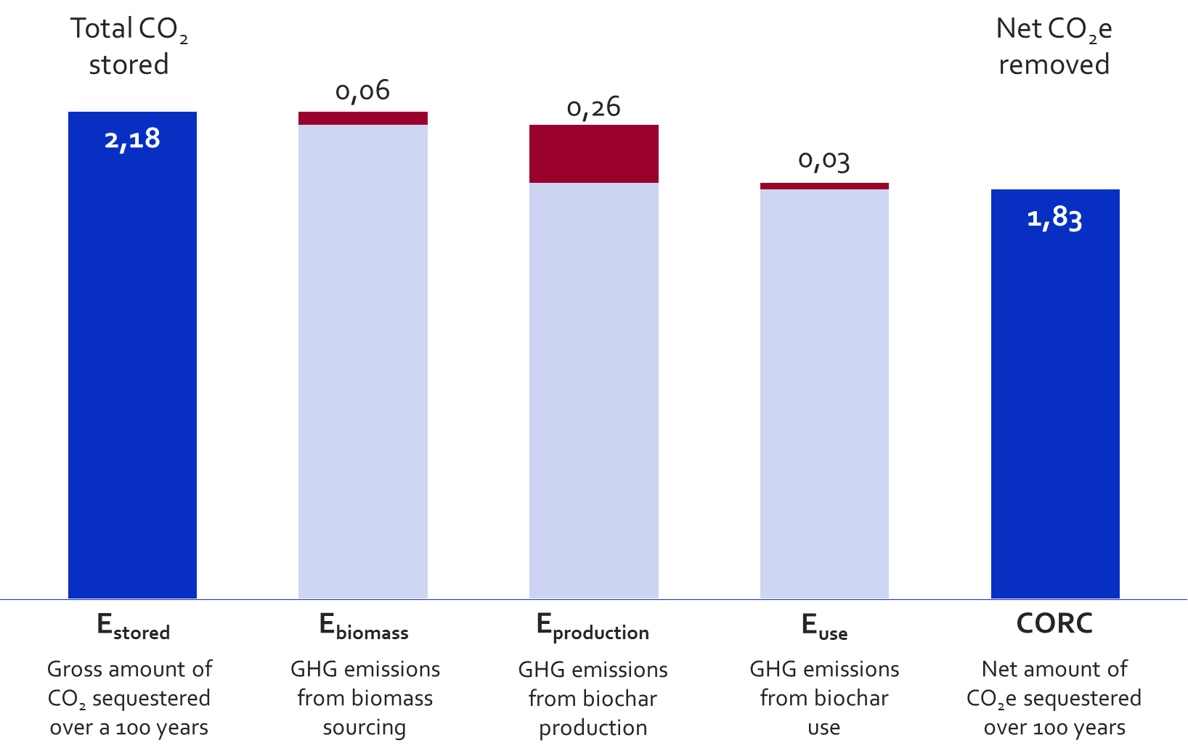
Supporting templates provided to registered suppliers
LCA Report template (as .docx file): illustrate the general structure of an LCA report
LCA Result reporting template (as .xlsx file): detailed results must be shared with Puro using a table format as demonstrated in this template; in particular if the LCA Model is not available to Puro because it was performed in a third-party software (e.g. SimaPro, Gabi, or other LCA software).
LCA Model template (as .xlsx file): illustrates how to structure an LCA in Excel to meet our transparency requirements and can be combined to CORC reporting documents for Output Audits.
Contribution levels |  | Per tonne of biochar produced and used
Level-1 | Level-2 | CC in kg CO2-eq | kg-CO2 fossil | kg-CO2 biogenic | kg CH4 as CO2-eq | kg N2O as CO2-eq | kg oGHG as CO2-eq
E_{biomass} | Step 1
E_{biomass} | Step 2
E_{production} | Step 3
E_{production} | Step 4
E_{use} | Step 5
E_{use} | Step 6
E_{stored}
Total (CORCs)

Slide 10
What to ask when hiring an LCA consultant to perform a Puro-compliant LCA study?
“Hello,
We are a carbon removal company working with **insert removal method**. We are seeking certification for issuance of carbon removal credits under the Puro Standard. For this we have a need of an LCA study that meets the requirements set by Puro and the specific scope defined in the **insert removal method** methodology. Here are links to the Puro Standard (https://puro.earth/documents/) and methodology (https://puro.earth/methodologies/). If you have not performed an LCA for Puro, you must know that it is similar to a product LCA.
We would need an LCA report and an LCA model to describe our activities at our planned facility **insert some details about planned facility**. More specifically:
The purpose of the LCA study should be to demonstrate the net-negativity of a removal activity in line with the scope defined in the Puro methodology.
The LCA report shall follow the general structure of an LCA report, and allow to demonstrate the validity of the structure of LCA model and justify all the assumptions and data choices that are made.
The LCA model shall allow us to calculate easily the amount of CORCs issued for a given reporting period, by adjusting key input data, without modifying the structure of the LCA that is described in the LCA report.
The LCA shall assess climate impacts using GWP100, make use of emissions factors with a full scope of emission factors (both in terms of greenhouse gases and life cycle stages), include major foreground infrastructure requirements, provide results in a disaggregated form (showing contribution analysis per i) life cycle stages, per ii) major greenhouse gas, and iii) not aggregating emissions and removals in single contribution), include an interpretation and sensitivity analysis, and include a list of input parameters that can be verified on site. Ideally, the LCA could also be verified by a 3rd party LCA reviewer.
**continue email with more commercial questions**
“
Ask technical questions!
What LCA software do you use? What LCA databases do you have access to?
How do you deal with multi-functionality in a product LCA?
What’s the difference between an LCA and a GHG inventory?
Are you familiar with Puro Standard and Puro LCA requirements? Are you familiar with the “Biochar” methodology from Puro?
Can you provide an easy-to-use Excel tool or similar in addition to the LCA report?
Check the list of LCA partners at https://puro.earth/partners/

Slide 11
Life cycle assessment (LCA) is the cornerstone of CORC calculation and issuance!
Initial eligibility
An LCA provides all the basis for a strong physical understanding of your removal technology.
It is essential for credibility & transparency, and ultimately enables access to carbon finance.
LCA is not just a formality, to be done at the end of your project development.
LCA needs some competence, knowledge & time. Invest in it early.
LCA has value along your project development:
LCA tools can be integrated to your engineering modelling
LCA can help making the right technological choices
Administrative registration
Reporting of CORCs and audits
Issuance of CORCs

